Slide 1
Healthcare Data Analysis
Leveraging Python, MySQL, for Healthcare Insights

Slide 2
Introduction to the project
The project focuses on the comprehensive management and analysis of healthcare workforce data, with a specific emphasis on Health Professional Shortage Areas (HPSAs) and Medically Underserved Areas (MUAs).
Objective: The primary goal is to provide valuable insights to healthcare planners, policymakers, and researchers. This involves making informed decisions regarding resource allocation, identifying areas with shortages, and addressing healthcare disparities.
Application Significance: The application serves as a valuable tool for optimizing workforce distribution, improving access to care, and ultimately enhancing overall health outcomes.
Data Source: The core data is derived from reliable healthcare databases or government health agencies, ensuring the reliability and accuracy of the information.
Key Features:
Analysis of distribution and characteristics of healthcare resources across different regions.
Identification of areas with shortages and disparities.
Facilitation of data-driven decision-making in the healthcare sector.
This sets the stage for a detailed exploration of the project's functionality and outcomes

Slide 3
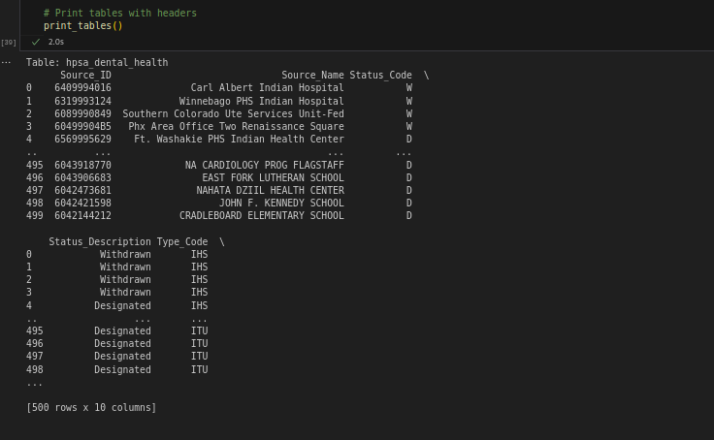
Database Schema Overview
Database Schema Design:
The schema captures essential information about Health Professional Shortage Areas (HPSAs) and Medically Underserved Areas (MUAs).
Designed for efficiency, the schema follows normalization principles to minimize data redundancy and enhance data integrity.

Slide 4
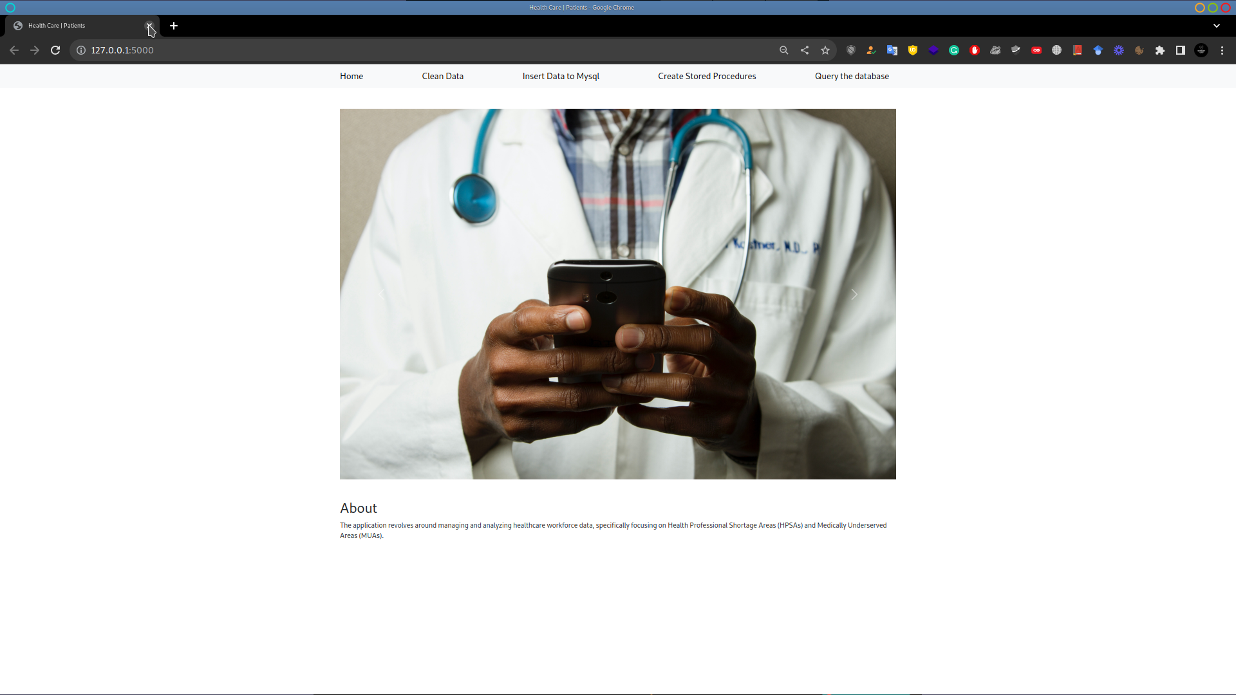
Access Data Homepage

Slide 5
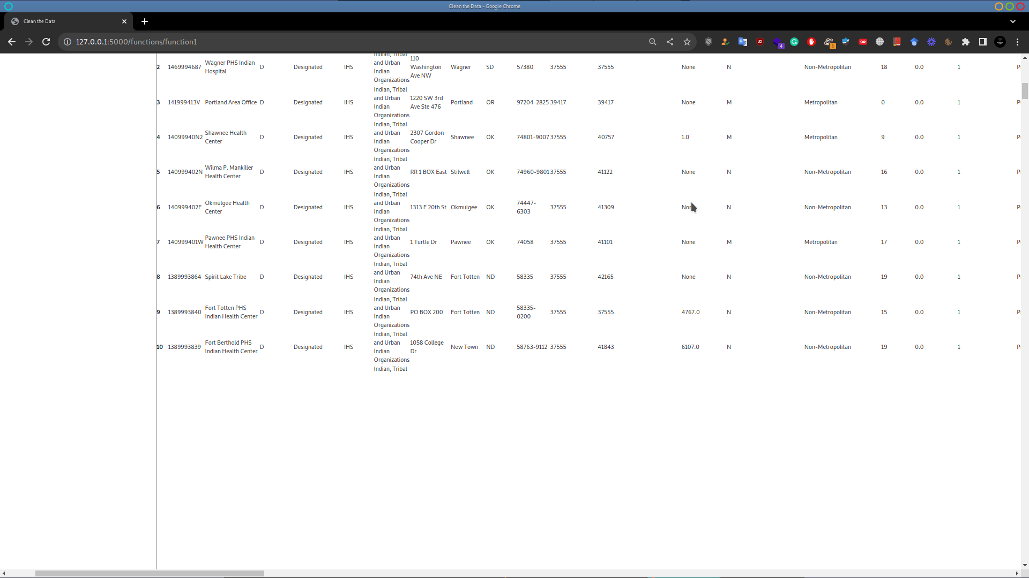
Clean the data

Slide 6
Stored Procedures & Queries
Stored Procedures:
usp_GetAverageScoreByMUAStatus:
Calculates and returns the average MUA score for each MUA status.
Usage: Provides an overview of average MUA scores based on different MUA statuses, aiding in identifying trends and disparities.
usp_GetHPSAByStateAndType:
Retrieves HPSAs based on the provided state abbreviation and type code.
Usage: Allows users to fetch specific HPSAs based on user-inputted criteria, facilitating targeted planning and resource allocation.
Queries:
Average Score of Designated MUAs:
Retrieves the average MUA score for designated areas.
Purpose: Displays a summary of MUA scores, aiding in understanding healthcare accessibility trends.
HPSAs in a Specific State and Type:
Fetches HPSAs in a particular state and of a specific type.
Purpose: Enables users to explore specific HPSAs based on state and type, supporting targeted healthcare planning.
Designated Mental Health HPSAs:
Retrieves information about designated mental health HPSAs.
Purpose: Offers insights into areas specifically designated for mental health services.
MUAs with the Highest Scores:
Identifies MUAs with the highest scores.
Purpose: Pinpoints areas with the greatest need for attention and resources.

Slide 7
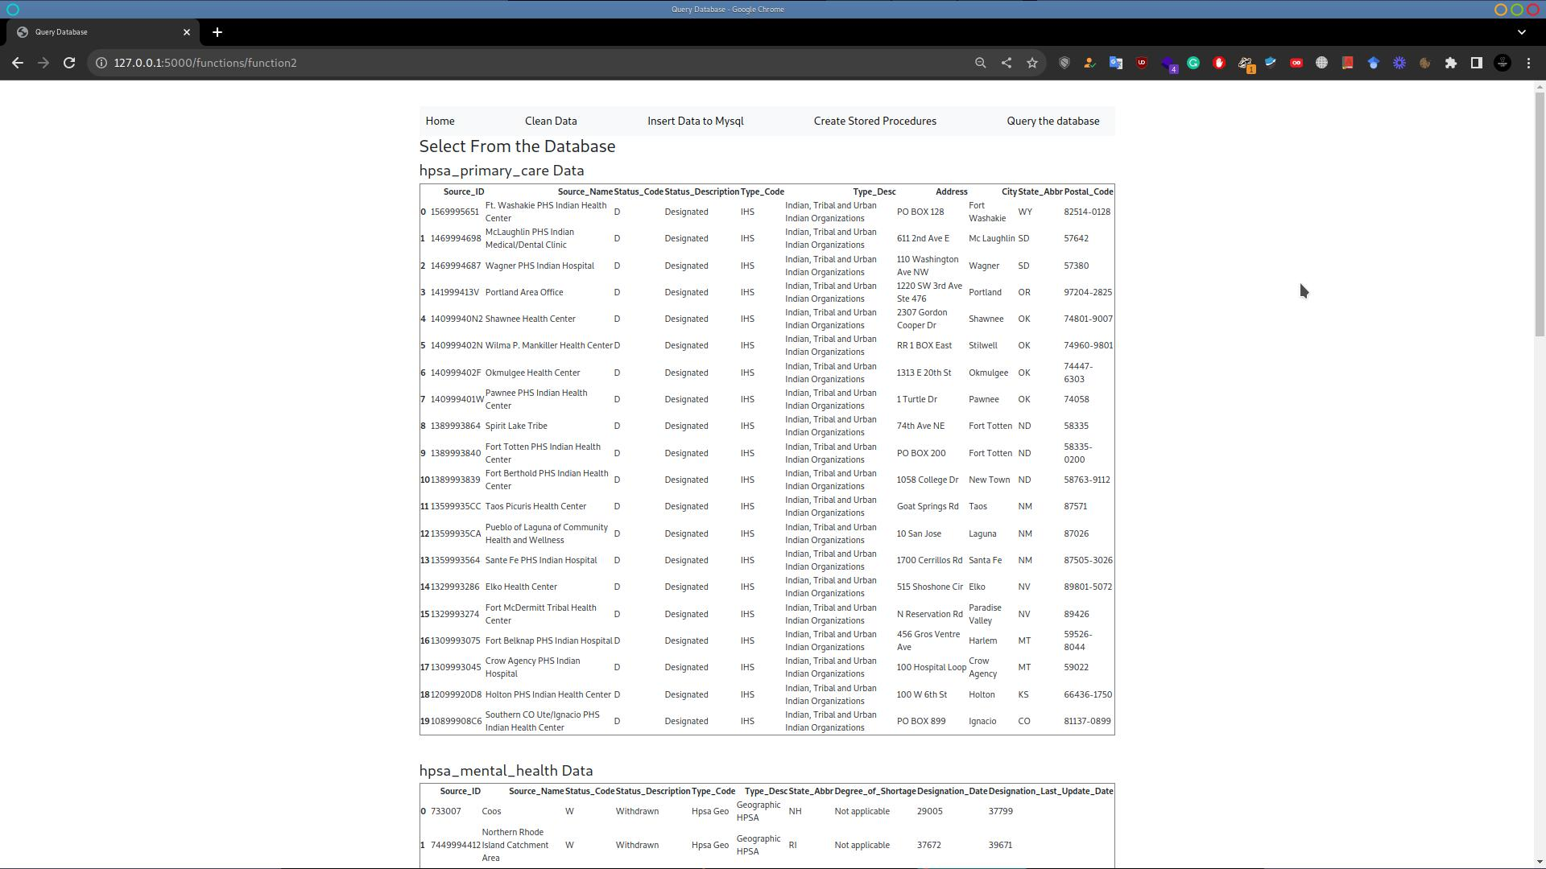
Insert data to MYSQL

Slide 8
Database Initialization and Data Insertion
Database Connection:
Attempts to connect to a MySQL database using provided host, user, password, and database information.
Table Creation and Data Insertion:
Defines four datasets, each representing a table (hpsa_primary_care, hpsa_mental_health, hpsa_dental_health, hpsa_mua).
Dynamically generates CREATE TABLE queries based on column names and types.
Executes CREATE TABLE queries to create tables in the MySQL database.
Prepares and executes INSERT queries to insert data from datasets into corresponding tables.
Commit Changes:
Commits the changes to the database for permanent effect.
Error Handling:
If any error occurs during the process (e.g., connection error, SQL syntax error), it prints an error message.
Connection Closure:
Closes the cursor and the database connection, ensuring proper cleanup.

Slide 9
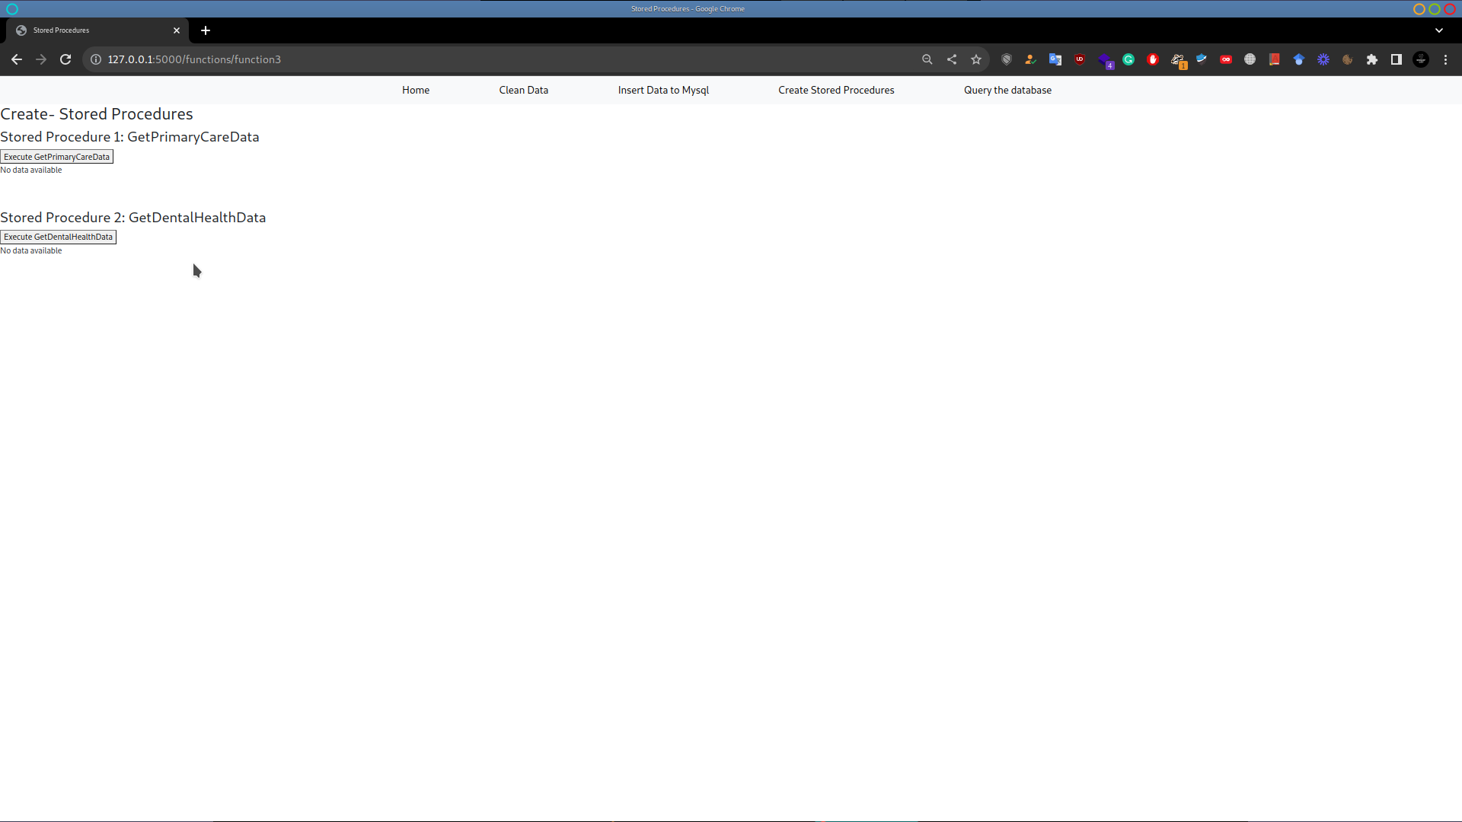
Stored Procedures

Slide 10
Interactive Query Execution
Functionality Overview:
Allows users to interactively input and execute SQL queries on the connected MySQL database.
Provides a flexible way to explore and retrieve data.
Database Connection:
Establishes a connection to the MySQL database using the mysql.connector library.
User Input:
Prompts the user to enter a SQL query they want to perform on the connected database.
Query Execution:
Executes the provided SQL query using the database cursor.
Fetching and Printing Rows:
Fetches all rows resulting from the query execution.
Prints each row to the console.
Error Handling:
Prints an error message if any error occurs during the process.
Connection Closure:
Finally, closes the cursor and the database connection.

Slide 11
Conclusion
User Interaction:
Enables users to perform user-defined SELECT queries interactively.
Enhances flexibility in retrieving specific information from the populated tables.
Future Development:
Lays the foundation for further development and analysis in the realm of healthcare data.
Potential for expanding functionalities, integrating additional datasets, and supporting more complex queries.
Overall Impact:
Combines data management, database creation, and user interaction to create a robust foundation.
Contributes to the efficient handling and analysis of healthcare workforce data.

Slide 12
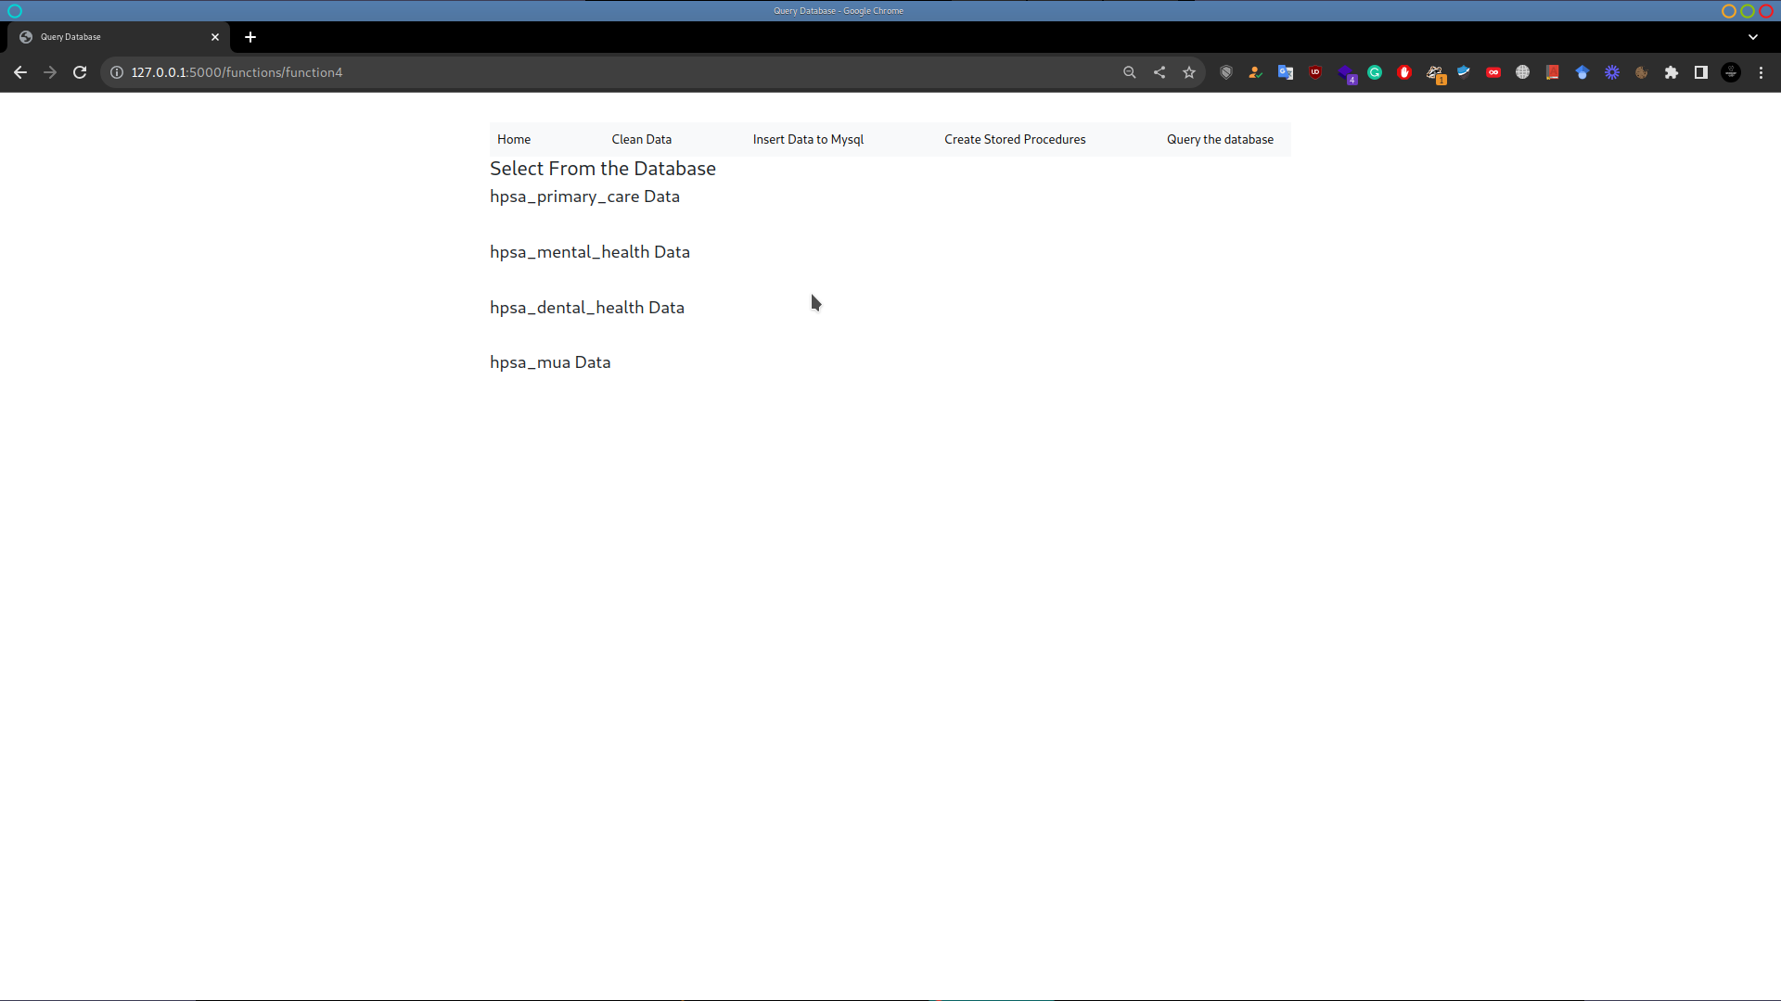
Query the Database

Slide 13
Conclusion
Project Highlights:
Successfully leverages Python and MySQL to initialize and populate a database with four tables.
Utilizes the pandas library for efficient dataset handling.
Dynamically generates SQL queries for table creation and data insertion.
Ensures proper error handling and connection closure.
Structured Database:
Four tables: hpsa_primary_care, hpsa_mental_health, hpsa_dental_health, and hpsa_mua.
Organized data on healthcare provider shortage areas, mental health designations, dental health designations, and medically underserved areas.

